Slide 1


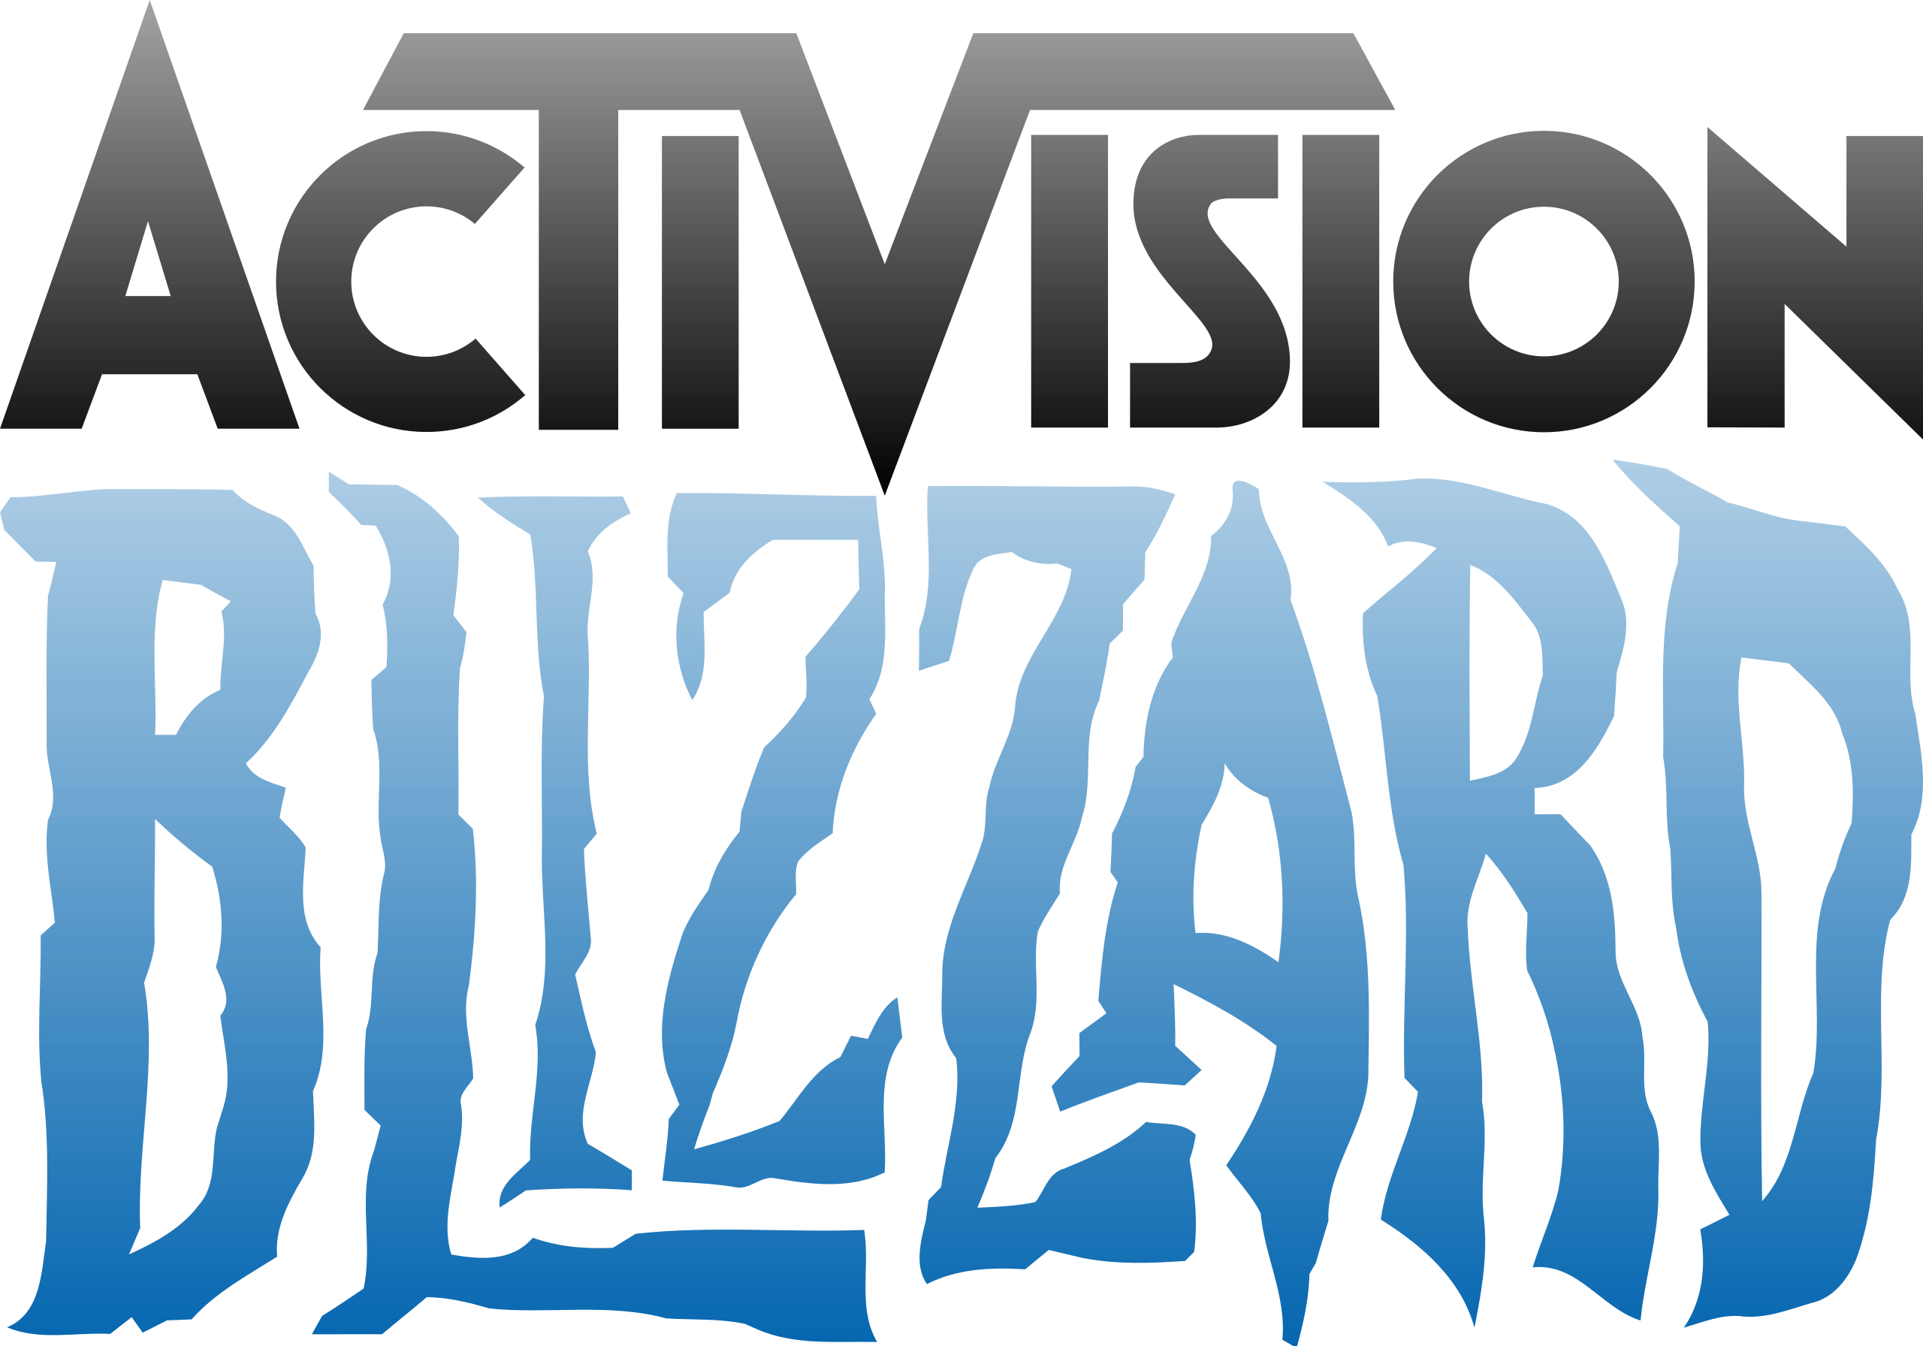

Group Project
FTC's Lawsuit Loss Regarding Microsoft's Acquisition of Activision Blizzard
AF3316 Investment
Presenter: XI Lexuan
April 11, 2025

Slide 2
Outline
Background
Part I – Event Study Analysis
Analysis before the event
Methods
Results
Discussion
Part II – Portfolio Analysis
Market beta analysis for 30 stocks before and after the event
Market beta analysis for 2 groups before and after the event
Market beta analysis for 4 groups before and after the event
Small Firm Effect
Investment strategy recommendation

Slide 3
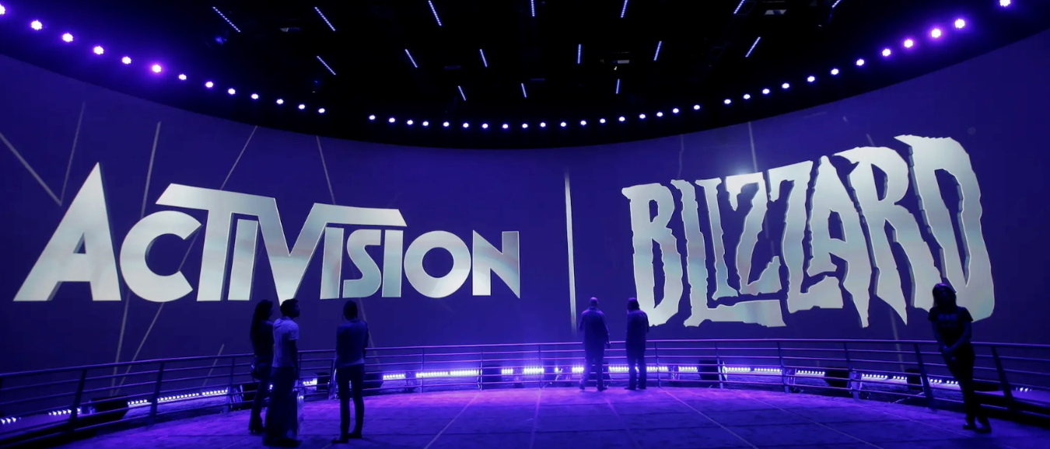
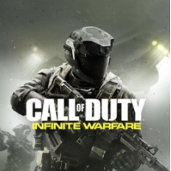
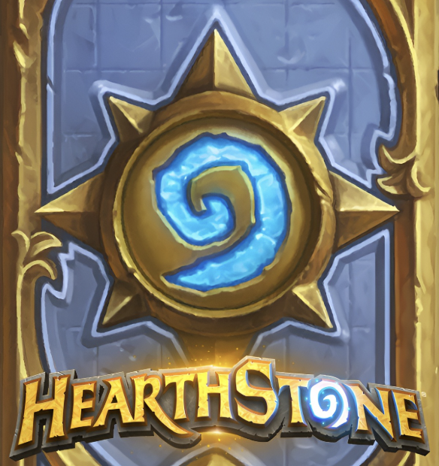
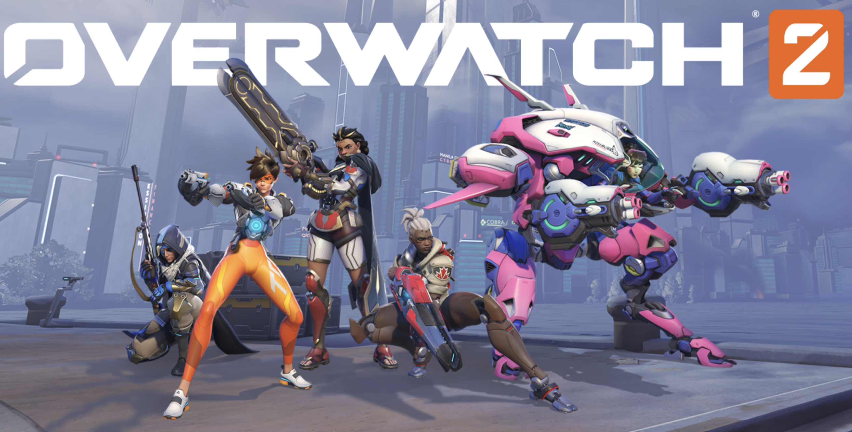
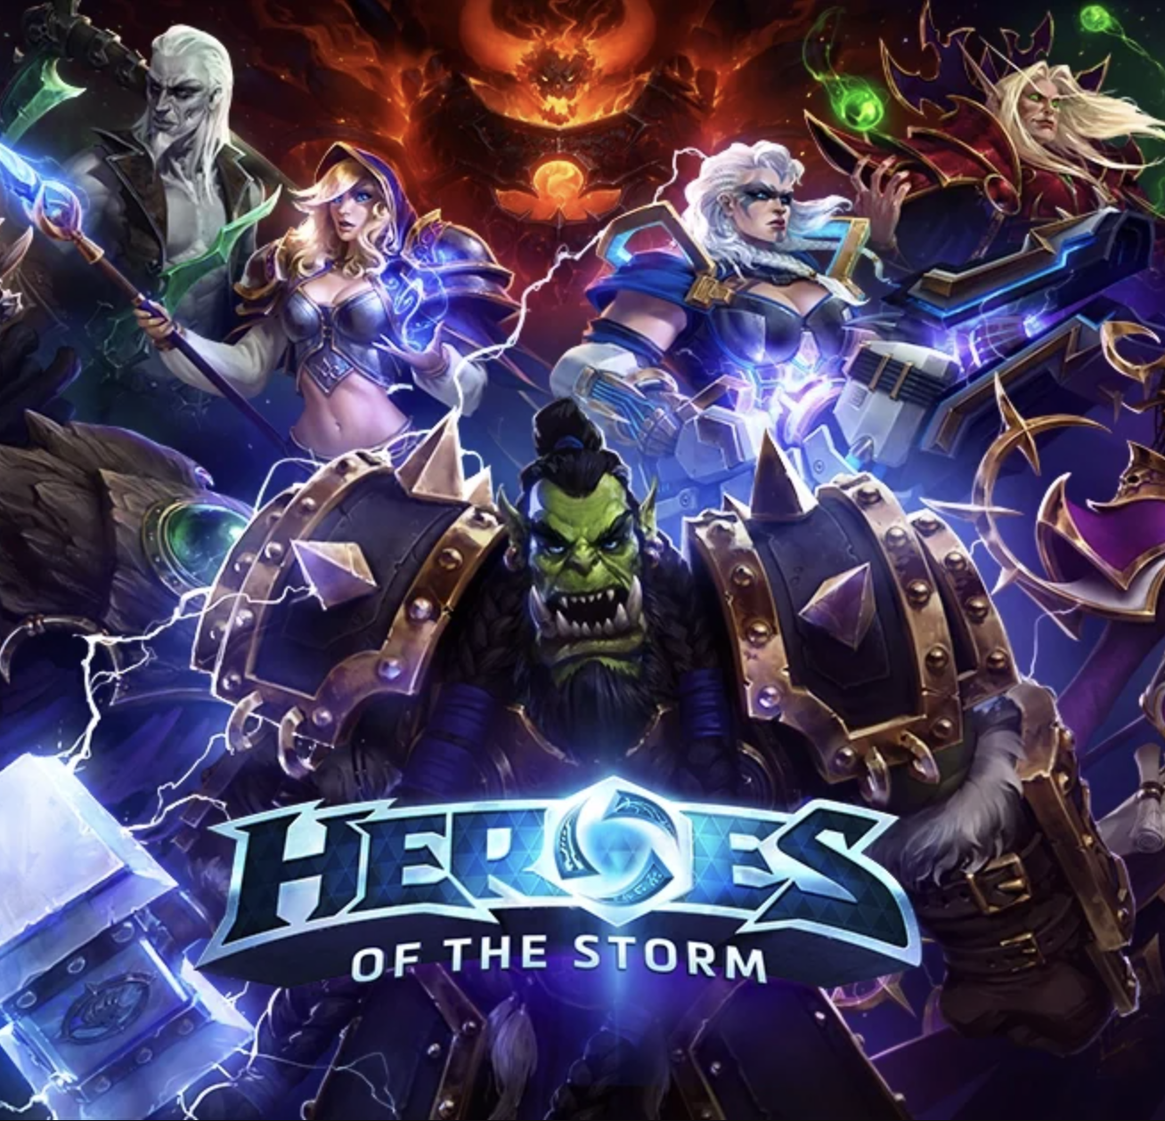
Part I - Background
Activision Blizzard, Inc. is an American video game holding company. Activision Blizzard currently includes three operating units: Activision, Blizzard Entertainment and King.
Among major intellectual properties produced by Activision Blizzard are:
Microsoft announced its intent to acquire Activision Blizzard for $68.7 billion on January 18, 2022.
Completed on October 13, 2023.
(largest video game and tech acquisition)
Time
Why does this acquisition take almost two years ?
3

Slide 4
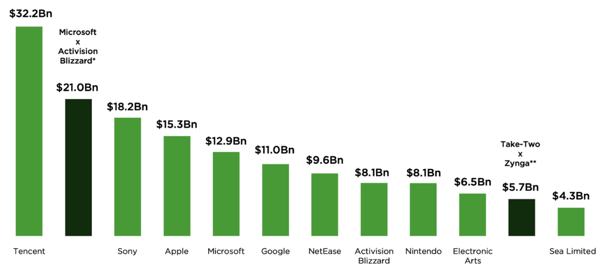
Part I - Background
Key reason:
Antitrust law
Top Companies by Game Revenues for 2021
Hart–Scott–Rodino Act requires notifying the U.S. Department of Justice's Antitrust Division and the Federal Trade Commission about any merger or acquisition over a certain size (HSR Act, 1976).
4

Slide 5
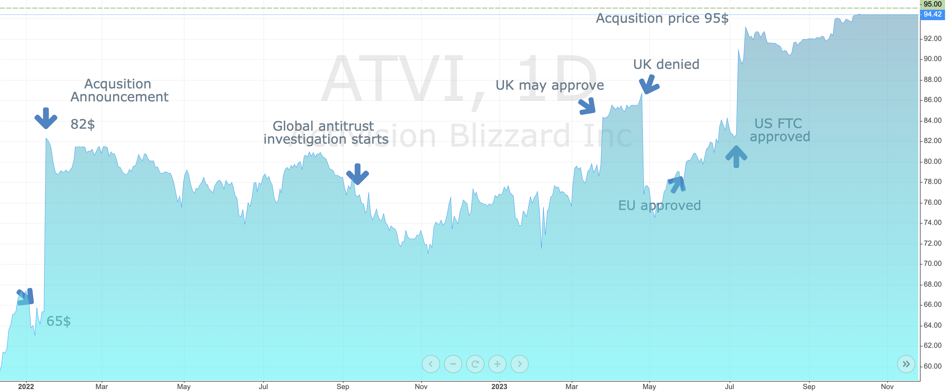
Part I - Background
Pivotal event:
US Federal Trade Commission (FTC) lost its lawsuit against Microsoft on July 11, 2023
Activision Blizzard Stock Price
5

Slide 6
Part I – Analysis before the event
Companies Directly Affected:
Microsoft:
On the one hand, This acquisition may strengthen the competitiveness of Microsoft’s Xbox gaming platform and subscription services such as Xbox Game Pass, solidifying its influential position within the global gaming ecosystem (Kadirov, 2024).
On the other hand, Investors might believe that Microsoft paid a premium for acquiring Activision Blizzard or took on debt to finance the acquisition.
Thus, the company’s stock price might not demonstrate significant fluctuations in response to this event.
Activision Blizzard:
Before the July 11th court ruling, Activision Blizzard’s stock traded at approximately $82 per share. Given Microsoft’s proposed $95 per share acquisition price, it’s reasonable to anticipate a significant upward pressure on the stock price as the deal approaches finalization.
6

Slide 7
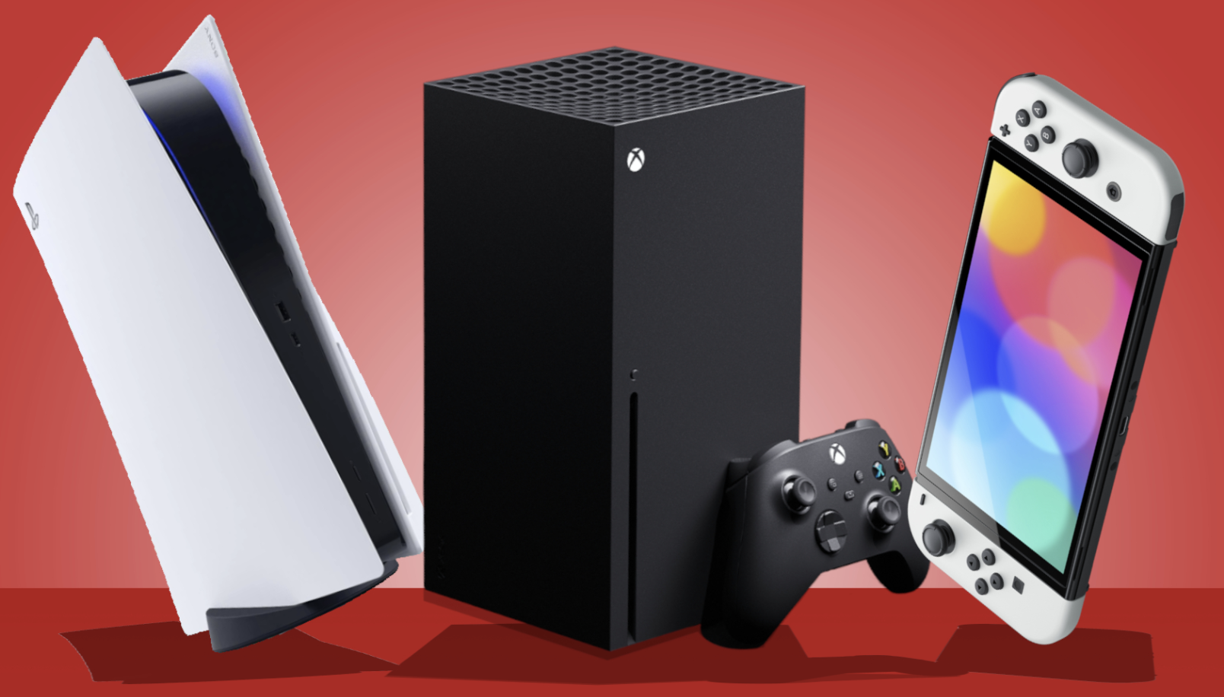
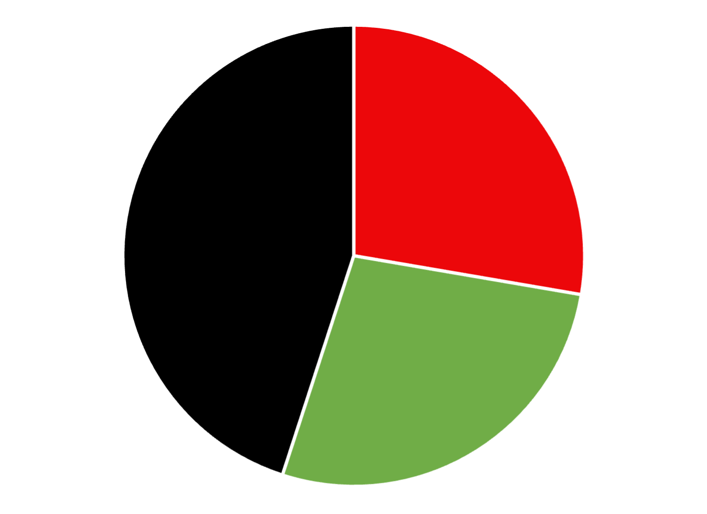
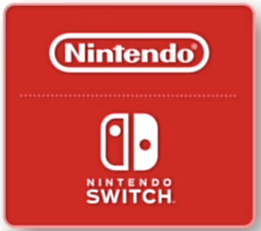
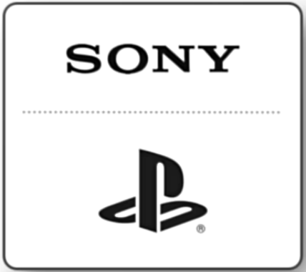
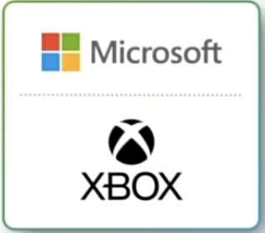
Part I – Analysis before the event
Major Competitors May Be Indirectly Affected:
Sony Group Corporation:
Sony’s PlayStation platform may confront exclusivity or timed-exclusivity risks regarding popular game titles like Call of Duty, potentially undermining Sony’s user base and gaming ecosystem.
Notably, Sony has emerged as one of the primary opponents in Microsoft’s acquisition case of Activision Blizzard.
Thus, these compounded challenges could trigger a noticeable decline in Sony’s stock price.
Nintendo Co., Ltd.:
The significant differences in user demographics and game genres between Nintendo and Activision Blizzard resulted in that this event is unlikely to affect its stock price substantially.
Global Console Gaming Market Company Share
28.2%
46.3%
25.5%
7

Slide 8
Part I – Analysis before the event
Broader Impact on the Gaming Industry and Partners:
After this acquisition, industry valuations for high-value IPs and large gaming companies may rise accordingly, potentially leading to accelerated industry consolidation. Therefore, some game publishers and developers (such as EA, Take-Two, Konami, etc.) could experience moderate increases in their stock prices due to these market dynamics.
Besides, the firms collaborating with Activision Blizzard in the gaming, entertainment, media, and technology industries may also experience mild stock price increases.
Impacts on Future M&A Deals:
The FTC’s defeat in this case may diminish its credibility. Other major corporations undergoing antitrust scrutiny at the time (such as Meta, Google, and Amazon) could potentially benefit from this outcome. While this constitutes an intriguing topic for discussion, we will concentrate the analysis on companies that experienced more direct and immediate impacts.
27.7%
45.0%
27.3%
8

Slide 9
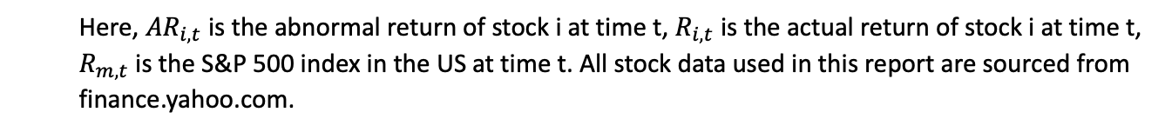
Part I – Methods
The market reaction to the acquisition is measured by the Abnormal Returns (ARs), Average Abnormal Returns (AARs), and Average Cumulative Abnormal Returns (ACARs), which a market-adjusted model computes.
Here, ${AR}_{i,t}$ is the abnormal return of stock i at time t, $R_{i,t}$ is the actual return of stock i at time t, $R_{m,t}$ is the S&P 500 index in the US at time t. All stock data used in this report are sourced from finance.yahoo.com.
Correlation analysis is adopted for further investigation in sensitivity.
9

Slide 10
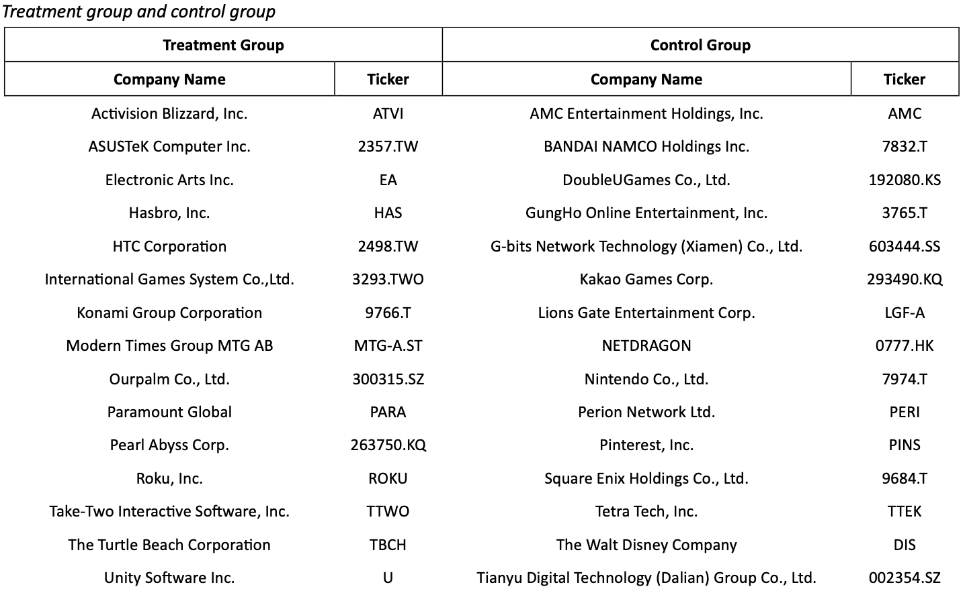
Part I – Methods
Treatment Group: 15 stocks with high exposure to the event
Control Group: 15 stocks with low exposure to the event but otherwise similar characteristics to the affected stocks
10

Slide 11
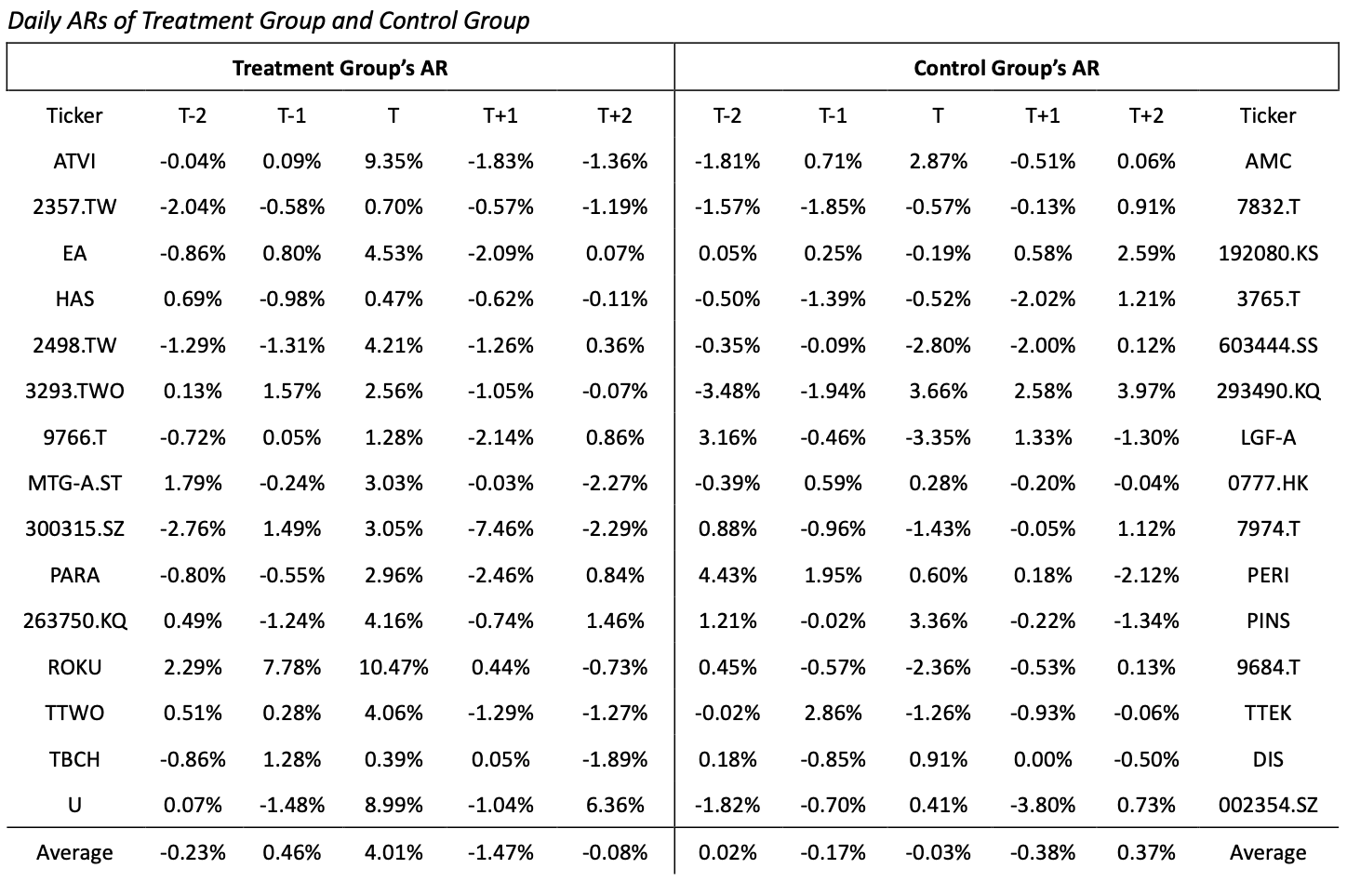
Part I – Results
11

Slide 12
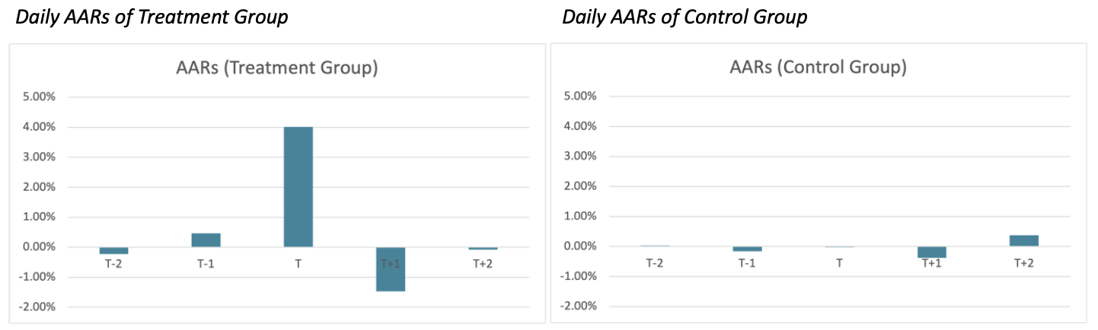
Part I – Results
Although the stock properties of the control group are similar to those of the treatment group, their stock prices showed no significant changes due to minimal impact from the event, with the AAR being merely -0.03% on day T. In contrast, the stock prices of the treatment group exhibited two distinct fluctuations. On Day T, the AAR suddenly increased from 0.46% on Day T-1 to 4.01%. By Day T+1, the AR had dropped to -1.47%. Among stocks of the treatment group, the most pronounced changes were observed in Activision Blizzard’s stock price, where the AR surged to 9.35% on Day T, followed by consecutive declines of -1.83% and -1.36% on Day T+1 and Day T+2, respectively.
12

Slide 13
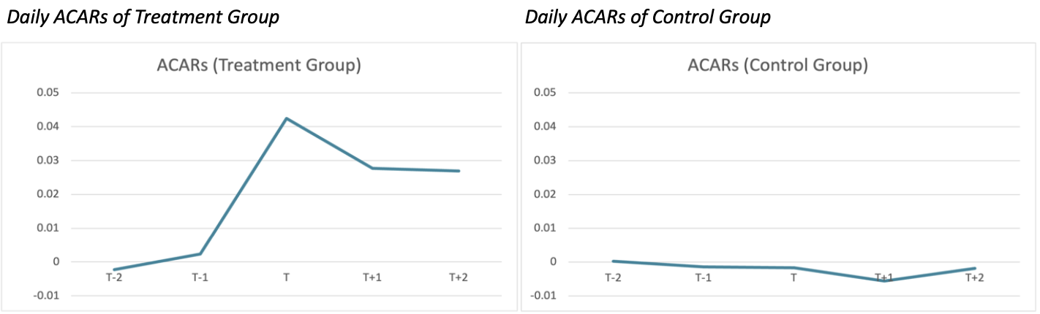
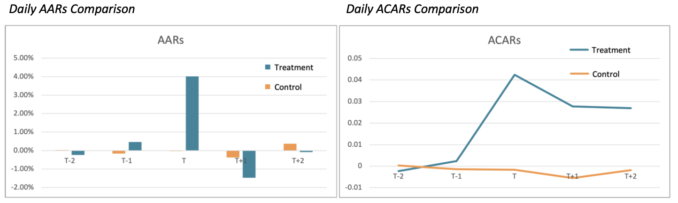
Part I – Results
13

Slide 14
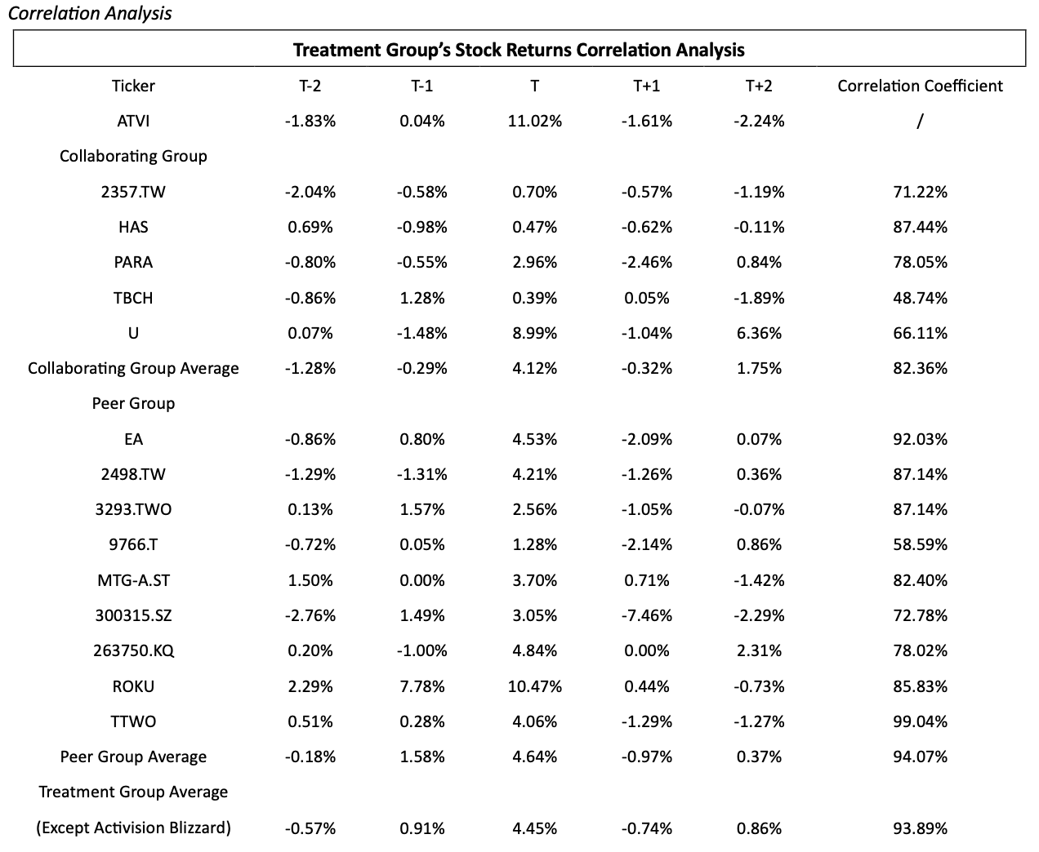
Part I – Results
14

Slide 15
Part I – Discussion
Following the court ruling on July 11, 2023, Activision Blizzard’s stock price surged nearly 10% on the same day, rising from $82.7 to $90.99 per share. Before Microsoft’s acquisition announcement on January 18, 2021, Activision Blizzard’s share price stood at $65.39. This indicates that before the ruling, the market had priced in approximately a 58% probability of acquisition success ((82.7 - 65.39)/(95 - 65.39)). Post-ruling, the implied market probability increased to about 86% ((90.99 - 65.39)/(95 - 65.39)), reflecting a nearly 30% boost in market confidence regarding Microsoft’s successful acquisition.
However, Activision Blizzard’s stock price experienced consecutive declines on day T+1 and day T+2. This suggests the market might have overreacted initially. Studies show that stock prices often exhibit short-term reversals following shocks (Atkins & Dyl, 1990; Brown & Harlow, 1988). This finding supports the Semi-Strong Form Market Efficiency to some extent.
The correlation analysis revealed that the stock prices of the Peer Group exhibited a correlation coefficient of approximately 94%, nearly 12% higher than that of the Collaborating Group, suggesting Peer Group stocks may be more sensitive to this event.
15

Slide 16
Part II – Market beta analysis
Period: October 2020 to December 2024
Capital Asset Pricing Model (CAPM) is used.
A regression analysis is conducted using $β_{i}$ as the independent variable and $E\left(r_{i}−r_{f}\right)$ as the dependent variable.
30 Stocks
Treatment Group and Control Group
4 groups: Control & Small (C&S), Control & Big (C&B), Treatment & Small (T&S), and Treatment & Big (T&B).
16

Slide 17
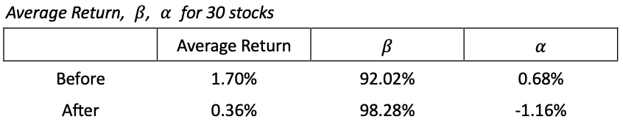
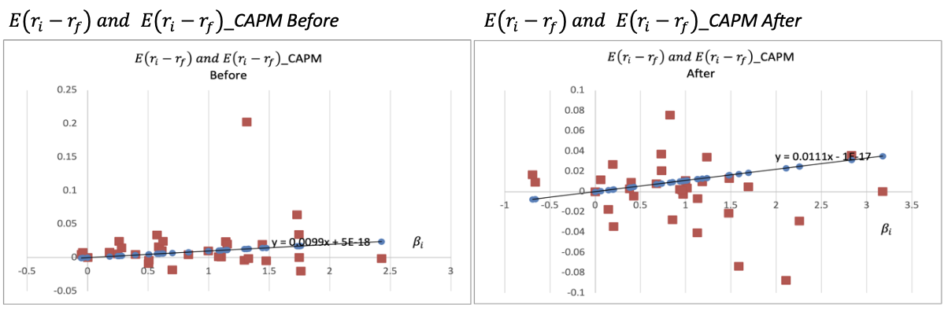
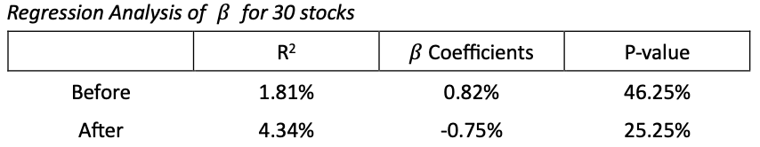
Part II – Market beta analysis for 30 stocks
17

Slide 18
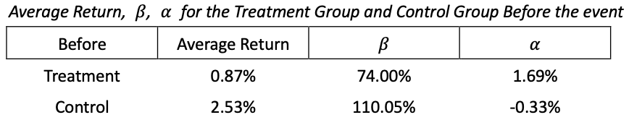
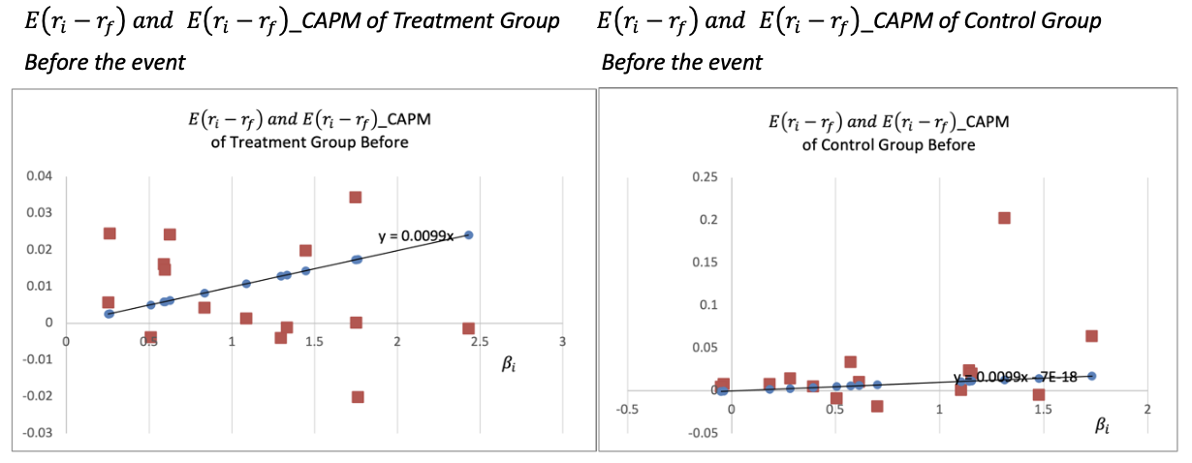
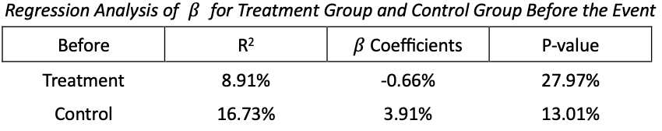
Part II – Market beta analysis for 2 groups
18

Slide 19
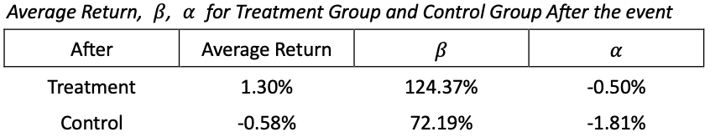
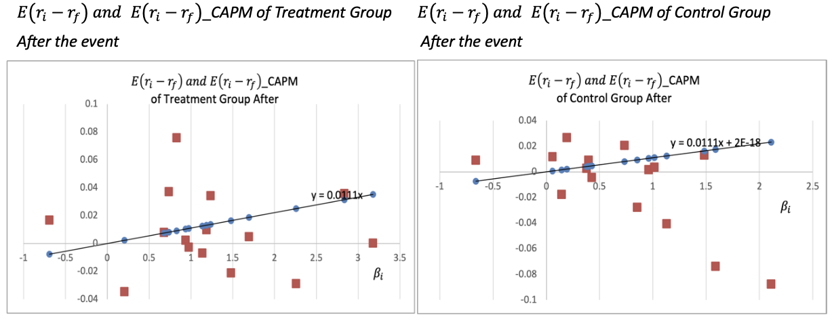
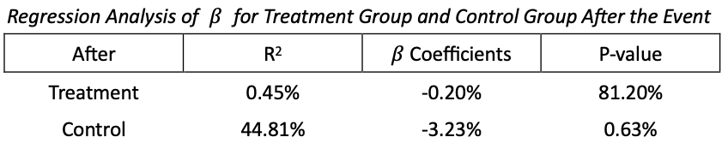
Part II – Market beta analysis for 2 groups
19

Slide 20
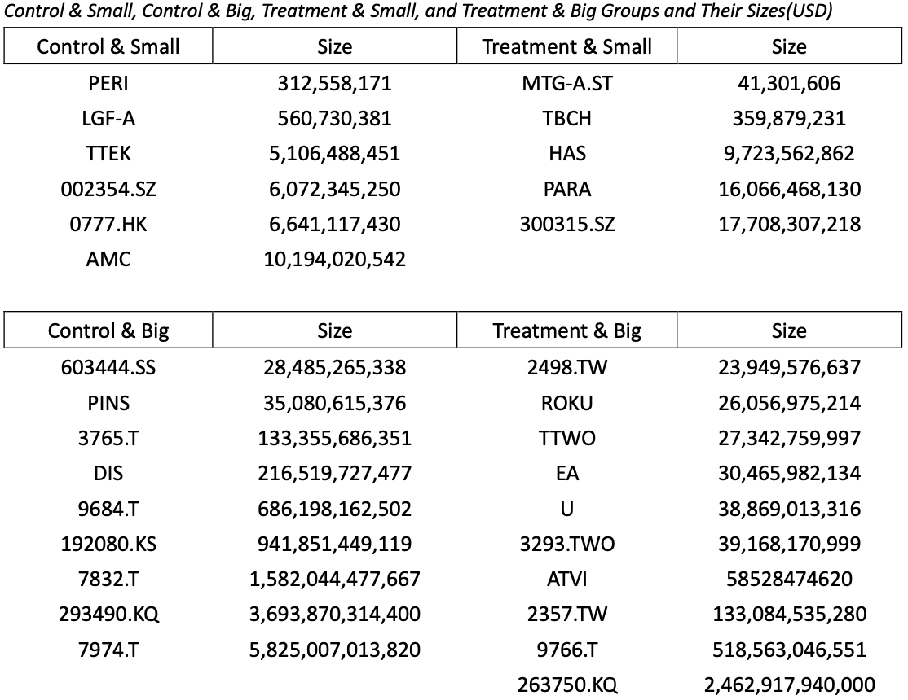
Part II – Market beta analysis for 4 groups
20

Slide 21
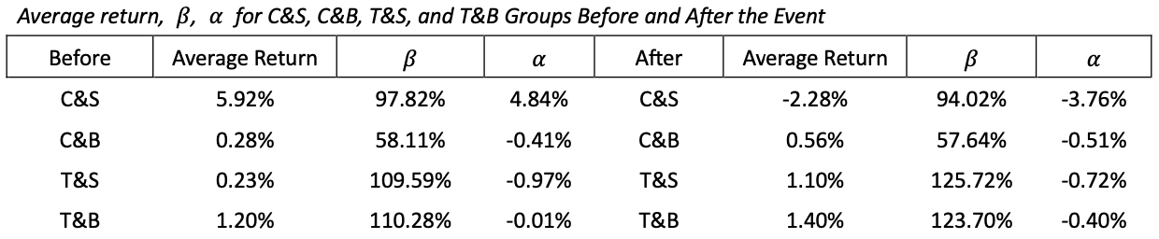
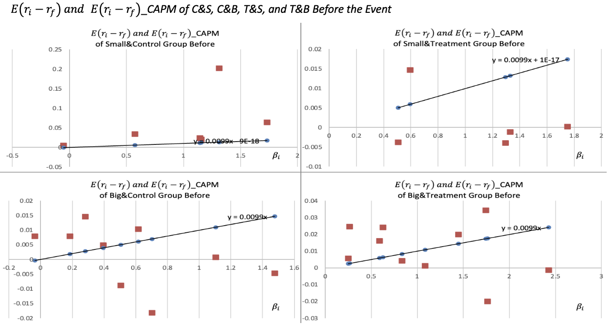
Part II – Market beta analysis for 4 groups
21

Slide 22
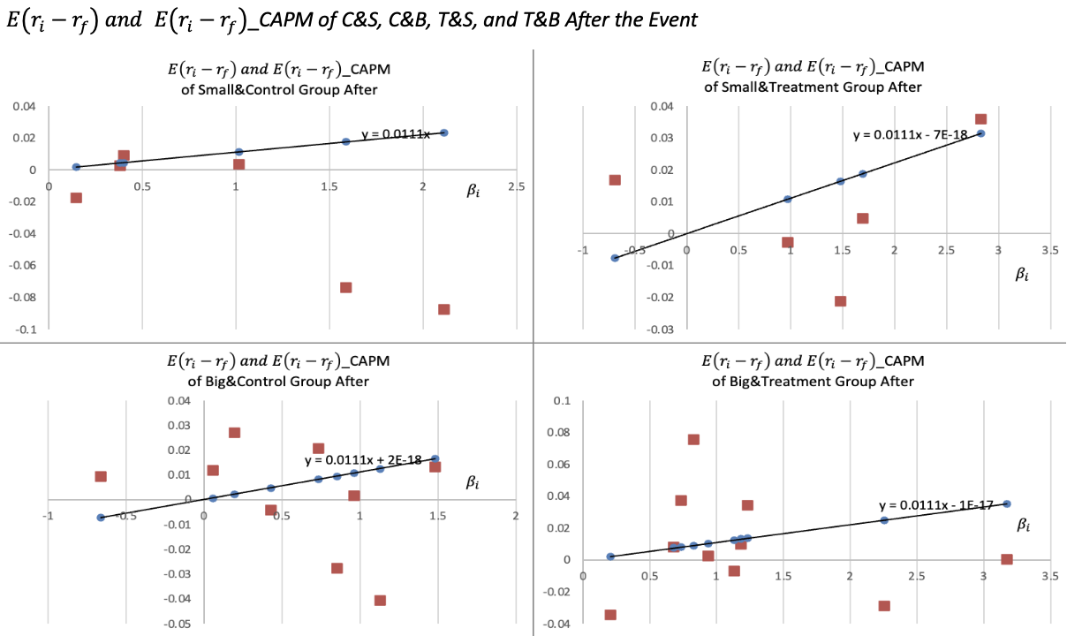
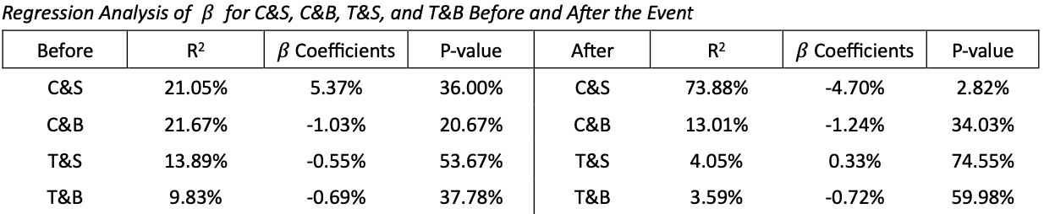
Part II – Market beta analysis for 4 groups
22

Slide 23
Part II – Market beta analysis and small firm effect
It can be observed that the CAPM doesn’t hold for any group, indicating that beta fails to account for the average returns among groups. One possible explanation is that other factors exist besides beta.
However, according to calculations based on the table below, the time-weighted average return for small firms is approximately 3.6%, about 2% higher than that for large firms. This result supports the existence of the long-term Small Firm Effect and violates the semi-strong form of the Efficient Market Hypothesis.
23

Slide 24
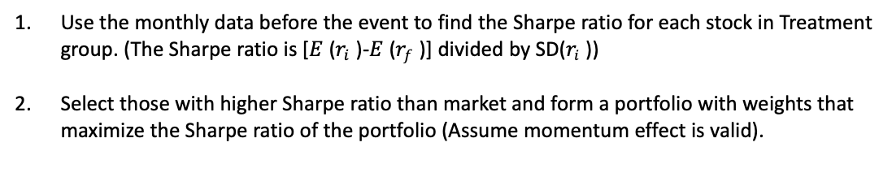
Part II – Investment strategy recommendation
Since CAPM is invalid in this case, the alpha calculated based on it may include errors that are not captured by beta. Therefore, using the CAPM's alpha for long-short strategies may be ineffective, as there is bias in alpha itself. (Other factors? Factor investing in quantitative finance)
Although there’s small firm effect during the whole period, small-cap strategy doesn’t perform well after the event.
If investors are optimistic about the value enhancement that Microsoft's acquisition of Activision Blizzard will bring to the treatment group (i.e. they want to hold some of stocks from the treatment group), A natural and simple strategy is recommended by this report as follows:
Use the monthly data before the event to find the Sharpe ratio for each stock in Treatment group. (The Sharpe ratio is [$E$ ($r_{i}$ )-$E$ ($r_{f}$ )] divided by SD($r_{i}$ ))
Select those with higher Sharpe ratio than market and form a portfolio with weights that maximize the Sharpe ratio of the portfolio (Assume momentum effect is valid).
24

Slide 25
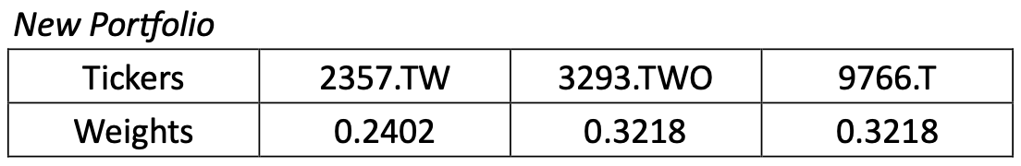
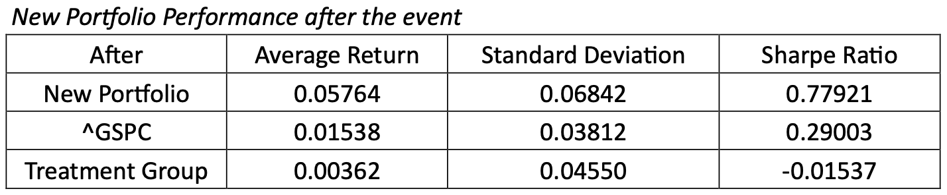
Part II – Investment strategy recommendation
The newly constructed portfolio shows that the strategy performs well in this case.
25

Slide 26
References
Atkins, A. B., & Dyl, E. A. (1990). Price reversals, Bid-Ask spreads, and market efficiency. Journal of Financial and Quantitative Analysis, 25(4), 535. https://doi.org/10.2307/2331015
Bartelson, E. (2022, May 13). Top 10 companies generate 65% of all game revenues: “Winners are huge” PreMortem Games. https://premortem.games/2022/05/13/top-10-companies-generate-65-of-all-game-revenues-winners-are-huge/
Brown, K. C., & Harlow, W. (1988). Market overreaction. The Journal of Portfolio Management, 14(2), 6–13. https://doi.org/10.3905/jpm.1988.409137
Hart–Scott–Rodino Antitrust Improvements Act of 1976, 94 U.S.C. § 435 (1976). https://www.loc.gov/item/uscode1958-004019005/
Kadirov, R. (2024). Microsoft and Activision Blizzard: The Rise of the Video Gaming Giant. https://scholarship.richmond.edu/cgi/viewcontent.cgi?article=1022&context=robins-case-network
Statista. (2023, November 14). Market share of console gaming market worldwide 2021-2022, by company. https://www.statista.com/statistics/1422309/console-gaming-market-share-worldwide/
https://github.com/xuanay/AF3316-Group-Project
26

